Slide 1
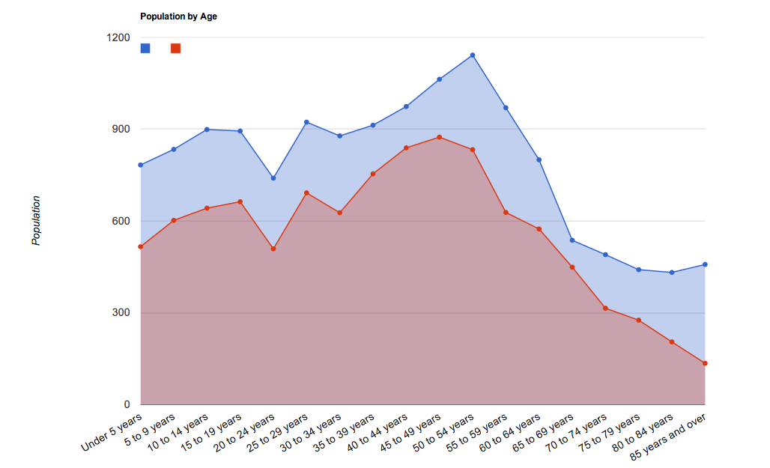
Population by Age
Working age citizens are mostly between 24-44
Children/Teens are mostly below the age of 14
Steep decline after age 50
Popular towns to move to to raise children
Many over the age of 20 leave (work/school)
Very similar patterns between the two towns
Blue = Cherry Hill, Red = Marlton

Slide 2
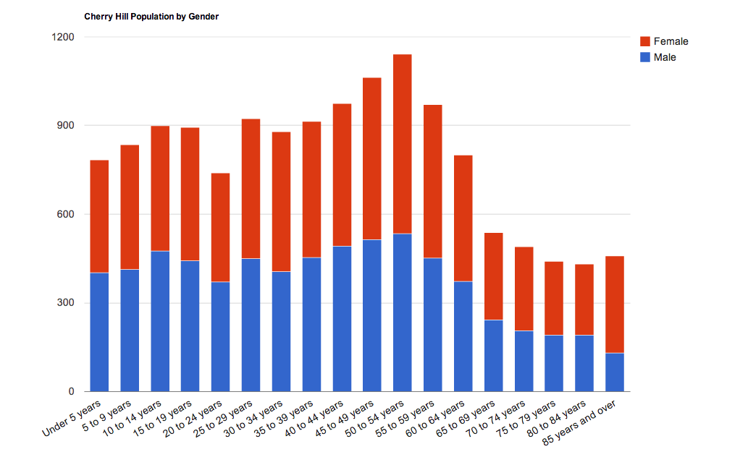
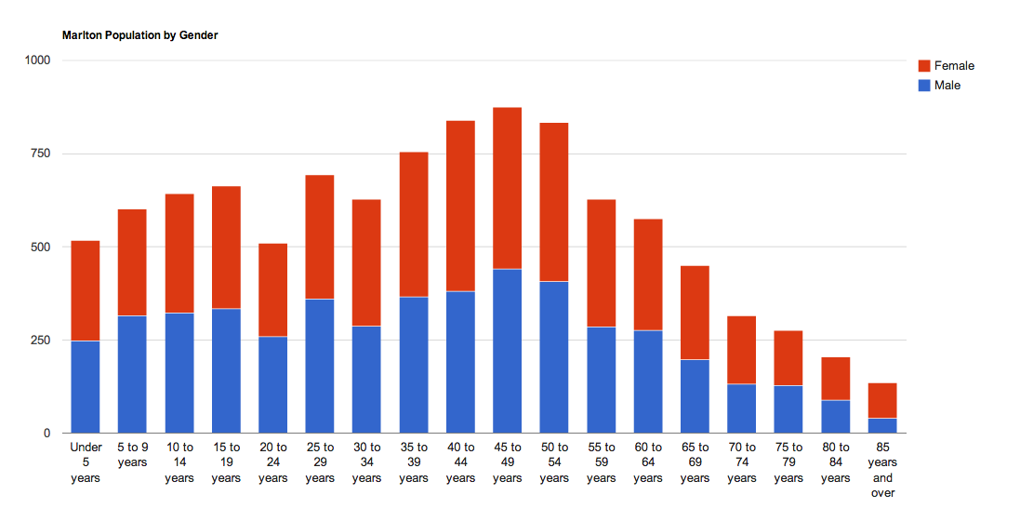
Population by Gender
Fairly even distribution of each gender
Older citizens skew towards female
Similar distribution between both towns
Both towns have a slightly more females (52%)
More equal below the age of 15

